Slide 1
Sill F.A.C.T.S.
May 6, 2025

Slide 2
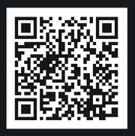

Slide 3
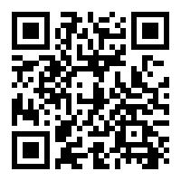
Sill F.A.C.T.S. Slides
sill.armymwr.com
Click on the Sill F.A.C.T.S. tab.

Slide 4
Welcome & Opening Remarks

Slide 5
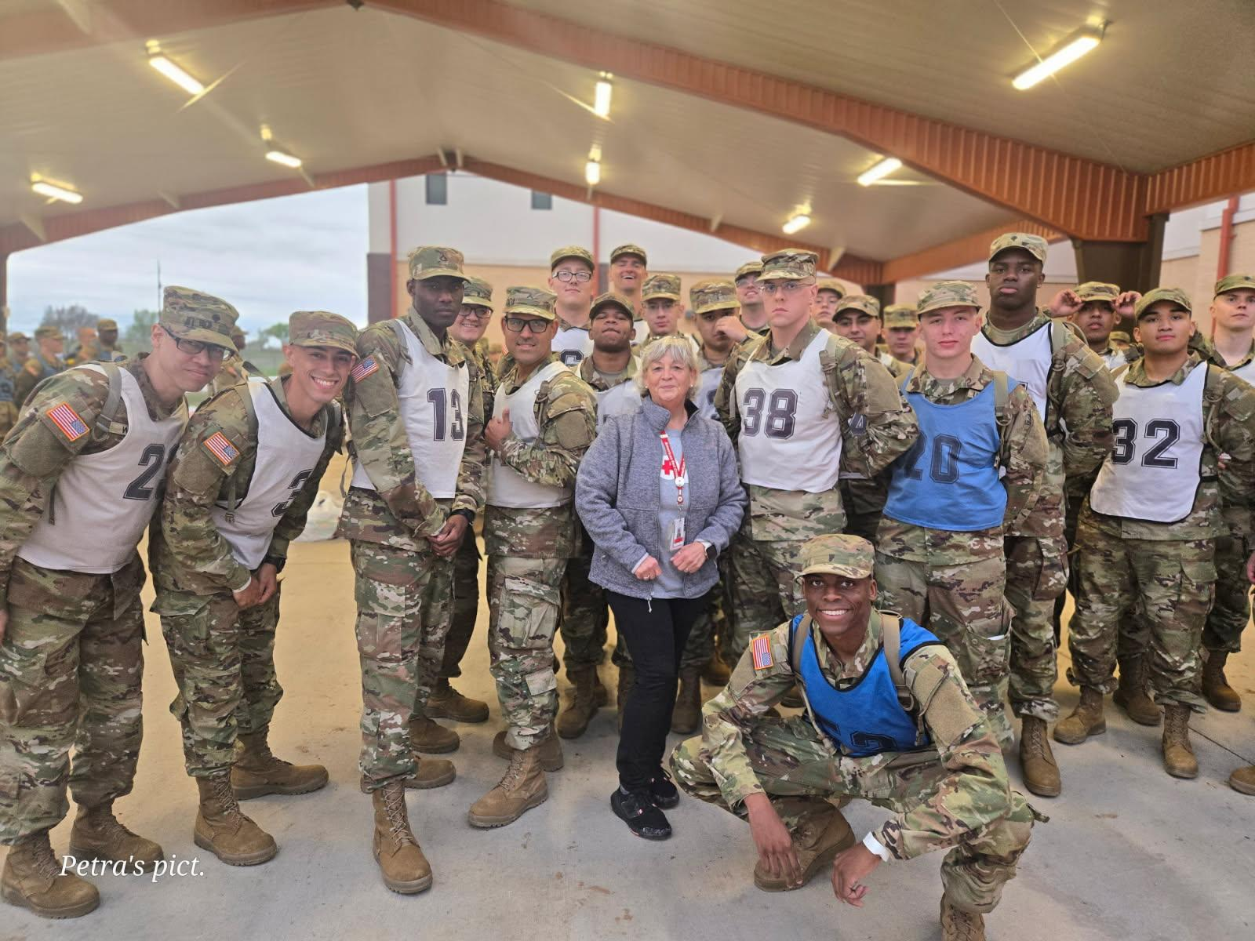

Slide 6
TEAM SILL
Notes:
Ladies and gentlemen, it is my honor to introduce an extraordinary young man who embodies the very spirit of determination and resilience: Tyler Heffner.
At just 12 years old, Tyler refused to let anything stand in his way—running the 13.1-mile Warrior Run Half Marathon on Fort Sill on March 22, despite using a prosthetic leg not even designed for running!
This was Tyler’s first time running a half marathon. In fact, he had only previously run two 5Ks at Fort Bragg. But when his mother, Ms. Audrina Heffner, told him he could participate in the 5K for the Warrior Run, Tyler set his sights even higher, choosing to push himself to the limit by tackling the half marathon distance instead.
His courage and unwavering perseverance paid off when he crossed the finish line and earned the top spot as the Overall Winner, First Place, Boys.
Tyler’s unstoppable spirit and strong will serve as an inspiration to us all. He is proof that obstacles are merely steppingstones on the path to our goals.
Today, we proudly present Tyler with his run plaque and celebrate not only his remarkable achievement, but also the bright future he has ahead—one that includes a new prosthetic leg specifically for running, and undoubtedly many more finish lines.\\
Please join me in congratulating this real-life superhero, Tyler Heffner, our little Warrior who shows us that determination knows no limits!

Slide 7
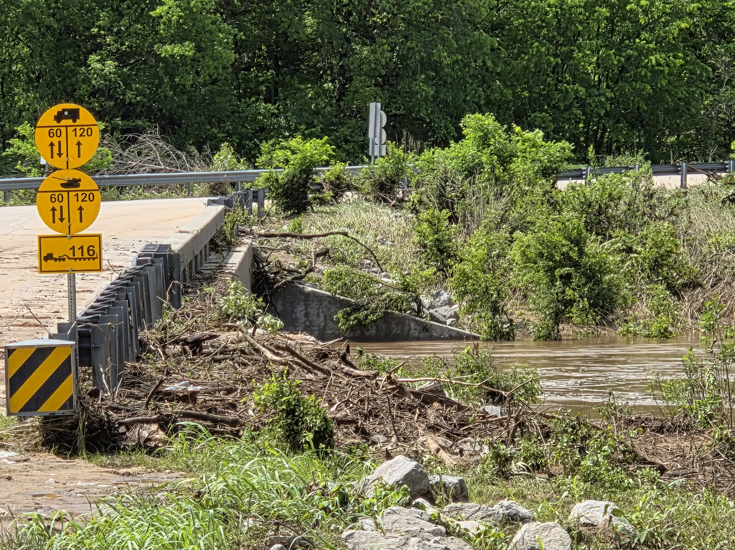

Slide 8
BRIGADE SPOTLIGHT
Directorate of Public Works Team is recognized for their exceptional response to the flooding event from 28 April – 2 May 2025. The DPW team’s proactive and sustained efforts, working around the clock, were instrumental in mitigating the impact of the flooding on Fort Sill. Their rapid actions directly contributed to a reduction in lost work hours and ensured the continued support and well-being of our Army families. These 15 dedicated team members worked around the clock, making sure critical facilities were restored quickly, minimizing disruption to missions across post. Thank you all, your efforts exemplify the strength of teamwork and the spirit of service.
Please join me in thanking this team for their efforts along with COL Baird and CSM Pearson.
Notes:
Ladies and gentlemen, it is my honor to introduce an extraordinary young man who embodies the very spirit of determination and resilience: Tyler Heffner.
At just 12 years old, Tyler refused to let anything stand in his way—running the 13.1-mile Warrior Run Half Marathon on Fort Sill on March 22, despite using a prosthetic leg not even designed for running!
This was Tyler’s first time running a half marathon. In fact, he had only previously run two 5Ks at Fort Bragg. But when his mother, Ms. Audrina Heffner, told him he could participate in the 5K for the Warrior Run, Tyler set his sights even higher, choosing to push himself to the limit by tackling the half marathon distance instead.
His courage and unwavering perseverance paid off when he crossed the finish line and earned the top spot as the Overall Winner, First Place, Boys.
Tyler’s unstoppable spirit and strong will serve as an inspiration to us all. He is proof that obstacles are merely steppingstones on the path to our goals.
Today, we proudly present Tyler with his run plaque and celebrate not only his remarkable achievement, but also the bright future he has ahead—one that includes a new prosthetic leg specifically for running, and undoubtedly many more finish lines.\\
Please join me in congratulating this real-life superhero, Tyler Heffner, our little Warrior who shows us that determination knows no limits!

Slide 9
Religious Support Services (RSS)
Chaplain Fisher

Slide 11
Army Community Service (ACS)
Ken Lewis, Financial Readiness & AERO Specialist

Slide 12
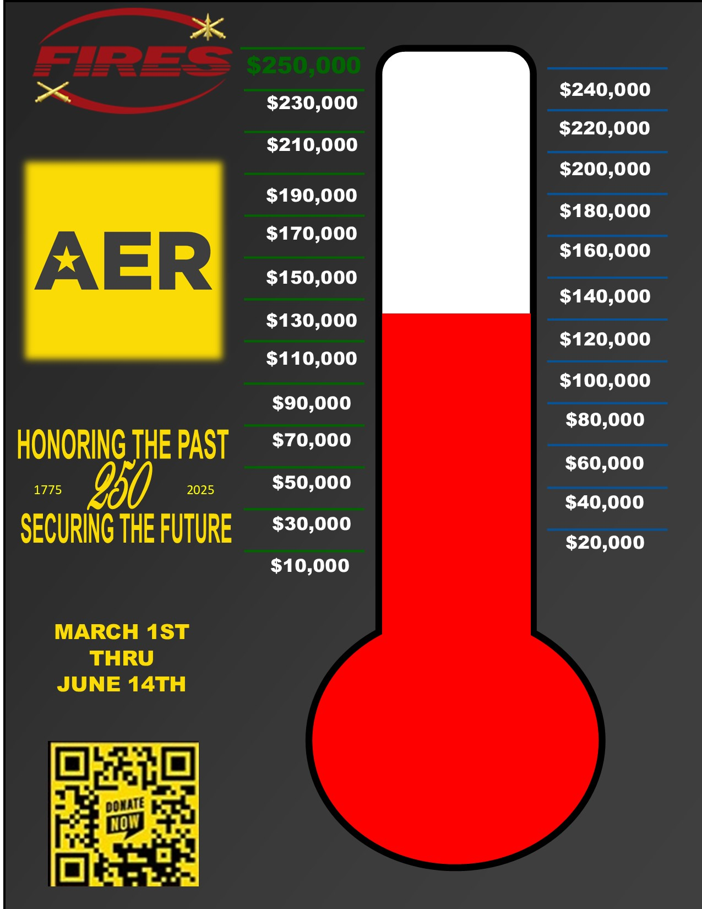
Fort Sill AER Campaign Goals
100% Service Member Informed of AER Benefits
$150,000+ in donations from Fort Sill personnel
ACS FACEBOOK

Slide 13
Army Family Spotlight Shaun Beauchamp, Family Advocacy Program Specialist

Slide 14
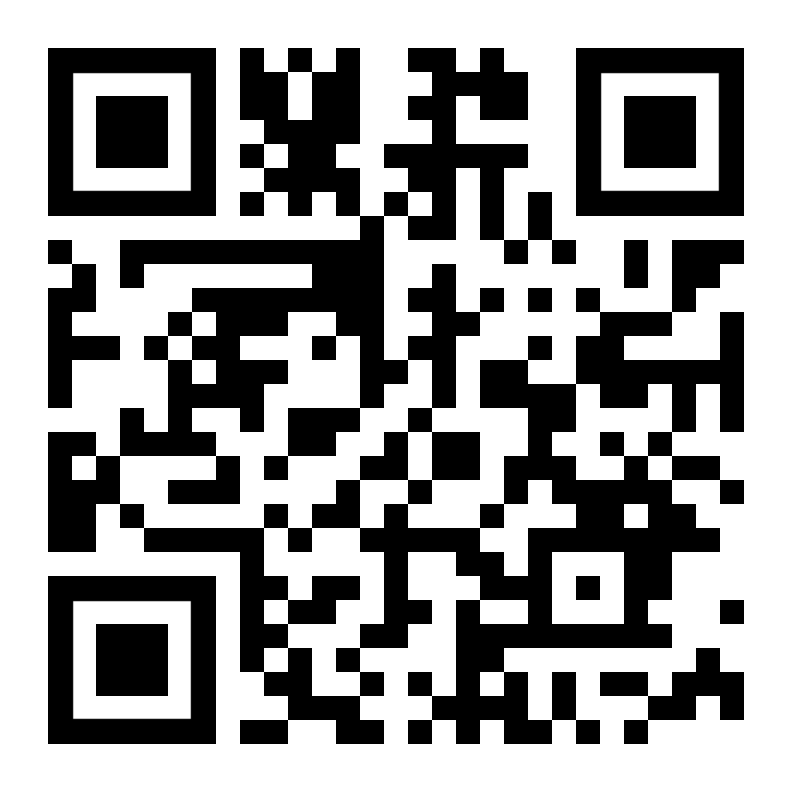
ACS FLYERS

Slide 15
Directorate of Emergency Services (DES) Mark E. Brown, Installation Physical Security Officer

Slide 16
Fort Sill Access Control
Key Gate West is tentatively scheduled to open on Friday, September 5, 2025.
Gate hours of operations are as follows:
Bentley Gate on Sheridan Road (24-hour gate)
Scott Gate (24-hour gate)
Apache Gate - Commercial deliveries, Monday-Saturday, 5 a.m.-7 p.m. / Closed Sundays & Holidays
52nd St Gate – 5 a.m.-10 a.m., Monday-Friday
Key Gate East – 5 a.m.-6 p.m., Monday-Wednesday / Family Day, 5 a.m.-7 p.m., Friday-Sunday 5 a.m.-6 p.m.
Key Gate West (Closed)
Hours of operation at the Visitor Welcome Center (VWC): Monday – Saturday 7 a.m.-5 p.m. / Closed on Sundays Any Holiday that falls on a Saturday or Monday the VWC is open 7 a.m.-1 p.m.
Advanced electronic pass requests are available on the following website,
https://sill-www.army.mil/vcc/ or by email at, usarmy.sill.id-training.mbx.fort-sill-visitor-control-center@army.mil
The Visitor Welcome Center (VWC) can be reached by phone during duty hours at (580) 442-9616 or 442-9617.

Slide 17
Family Morale, Welfare & Recreation (FMWR) Ethan Briner, Events Coordinator

Slide 19
MWR FACEBOOK
MWR WEBSITE

Slide 20
MWR WEBSITE

Slide 21
MWR- Aquatics

Slide 22
Quinette Outdoor Pool
​
Family Season Pass:​
Active Duty/DOD ID Card holders
Individual $90.00​
Family of 2 $95.00 ​
Family of 3 $120.00 ​
Add’l Fam. Member​
above 3 = $20/ea​
Hours of Operation:
Friday–Tuesday, 11 a.m.–5 p.m.
Wednesday & Thursday, CLOSED
Prices:
Active Duty/Dependent: Age 5–17, $4/person/visit
Age 18 & Older, $5/person/visit
DoD Civilian/Dependent: Age 5–17, $5/person/visit
Age 18 & Older, $6/person/visit
​Civilian​
Individual $70.00 ​
Family of 2 $115.00​
Family of 3 $140.00​
Add’l Fam. Member​ above 3 = $25/ea
Rhinehart Indoor Pool
Hours of Operation:
Monday–Friday, 5:30 a.m. – 1 p.m.
Monday–Thursday, 4 p.m. 7:30 p.m.
Saturday, 10 a.m.- 3 p.m.
Holidays/Training Holidays, 8 a.m. – 3 p.m.
Sunday, CLOSED
Private Party Reservations ​ (https://sill.armymwr.com/programs/pools)​
​

Slide 23
Fort Sill American Red Cross Learn-to-Swim Program
The Fort Sill ARC LTS Program will be held at Rinehart Indoor Pool, 2730 Bragg Road, Fort Sill.
There will be an option for enrollment into either an afternoon session or an evening session.
Sessions will meet (4) four times a week for (2) two weeks; (8) eight classes per session. Cost: $65.00/participant.
Registration for children will be handled through CYS Parent Central Services, (580) 442-3486/3927/4836.
Registration for adults will be handled at Rinehart Indoor Pool.
Summer Session 1: 2 June – 12 June
LTS SS1 Registration: 23 May – 30 May
LTS SS1 Swim Evaluation: 24 May
Summer Session 2: 23 June – 3 July
LTS SS2 Registration: 13 June – 20 June
LTS SS2 Swim Evaluation: 14 June
Summer Session 3: 14 July – 24 July
LTS SS3 Registration: 7 Jul – 11 July LTS SS 3 Swim Evaluation: 5 July

Slide 24
MWR- Outdoor Recreation
Brianna Wilcox, Outdoor Recreation Director

Slide 25
LETRA Lake Elmer Thomas Recreation Area
RENTALS ARE OPEN! 10 a.m.- 4 p.m., Saturday and Sunday
Park Opens on May 23 at 11 a.m. with Free Admission to the park all day!
Gate fees are $6 per car for Active Duty, Veterans, and DOD ID Card Holders and $8 per car for Civilians
Upcoming Events:
May 3 – Bass Tournament
May 9-11 – Mother's Day Cabin Special
May 10 – Hike Fort Sill
May 24 – Movie on the Beach
May 24 – Paint the Park
May 31 – Kayak Night Tour
May 31-June 1 – Introduction to Kayaking

Slide 26
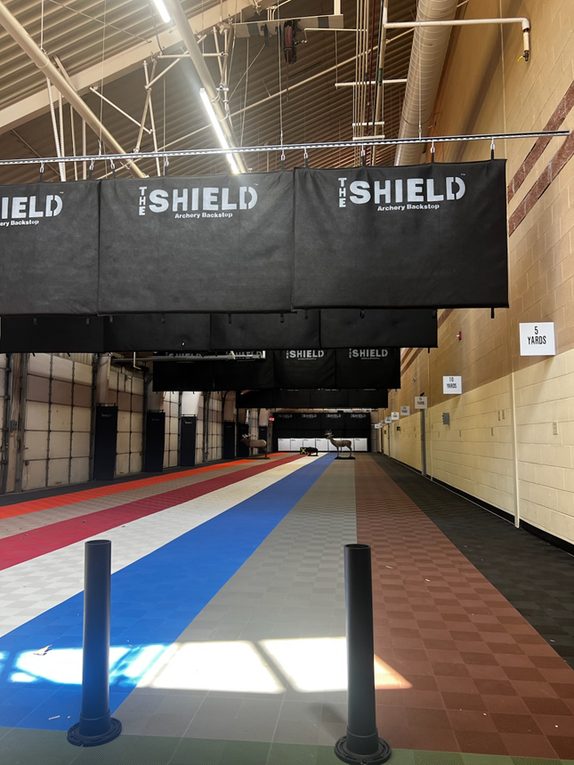
Outdoor Adventure Center
Cycling Challenge
May 1 – August 31
All participants receive a cycling jersey this year!
Can compete as a family! (only one jersey and one coin per family)
Receive coins that interlock if you complete 500 KM and 1000 KM.
You must keep track of your miles in an app for proof of miles ridden.
Indoor Archery Range

Slide 27
Warrior Adventure Quest
Brianna Wilcox, Outdoor Recreation Director

Slide 29
Child and Youth Services (CYS)
Kelsee Mullins, Youth Sports Director

Slide 30
Transportation Provided from
Youth Center (Building 1010) to LETRA:
Drop-off at 7:15 AM
Bus departs for LETRA at 7:30 AM
Bus returns at 11:30 AM

Slide 31
Corvias | Housing Steve Walls, Assistant Operations Director

Slide 32
PCS Season–Getting Prepared
30-Day Notice is Key: Remember that you need to give Corvias at least 30 days' notice before you move out to avoid any late notice fees.
Short Notice Orders: If you receive your official orders less than 30 days before your departure, ensure they are delivered to Corvias within 5 days of receiving them. This will help you avoid those late notice charges.
Don't Wait for Orders to Give Notice: You don't need your official PCS orders to submit your Notice to Vacate. If you have a good idea of when you'll be moving, it's a good idea to contact Corvias. They can help you create a move-out timeline.
Schedule a Pre-Inspection: This is a very helpful step! Contact Corvias to schedule a pre-inspection of your home. This walk-through will help identify any potential damages, some minor repairs you can do yourself to avoid charges later. Plus, it helps Corvias understand which homes might need more time to get ready for the next service member.

Slide 33
Army & Airforce Exchange Services (AAFES)
Hollie Morales, General Manager Fort Sill Consolidated Exchange

Slide 35
Bobby Wooldridge Senior Operations Manager

Slide 37
Red Cross Hero Center

Slide 38
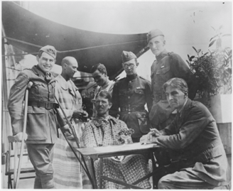
SAF Hero Care Center
Located at 1651 Randolph Rd on Fort Sill (next to the PX, across ADA HQ)
We provide comfort and support to members of the U.S. military 24 hours a day, 7 days a week. We are one of three American Red Cross Service to the Armed Forces (SAF) Hero Care Centers around the world and the only in-office location. Currently there are 84 regular full time staff members at the Fort Sill Hero Care Center from a total of around 175 staff members with the Hero Care Center.
At the Hero Care Center, we service ALL branches.
Last fiscal year we delivered a total of
55,800 Red Cross messages
34,289 to the Army (901 National Guard; 33,388 Active Duty)
480 to Fort Sill
Provided Financial Assistance for 3,357 clients; $5,838,836.00
Hurricane Helene (Ft. Stewart + Ft. Bragg) – 1,494 clients; $828,927.00

Slide 39
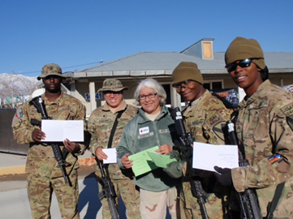
Our Services at the Hero Care Center
Emergency Communications ~ Provide independent information and verification of the emergency (including emergencies abroad)
Death
Critical Illness/Injury
Birth, Pre-Birth
Other emergency by exception (abuse, child/dependent breakdown, child placement, custody or adoption, legal proceedings, crime…)
Suicide Prevention Activity
Financial Assistance with the DoD Financial Assistance Programs
Access to Military Aid Societies
Emergency Travel
Assistance for essentials
Critical Communication Services for Veterans
Restoring Family Link ~ US caller looking for relatives located outside the US that are living in a conflict affected area; displaced by armed conflict; detention; located in a disaster-affected country
877-272-7337

Slide 40
Red Cross
Kathy Anselmo-Henke

Slide 41
APPLICATION DEADLINE:
Sunday, May 11, 2025
2025 Summer VolunTEEN Program
ELIGIBILITY REQUIREMENTS
The American Red Cross VolunTEEN Program is a 6-week summer program that allows military affiliated teens the opportunity to gain professional development skills while giving back to the military community by volunteering over the summer at Reynolds Army Health Clinic at Fort Sill.
Ages 14-17
Must be military-affiliated
Must be a U.S citizen
Ability to meet the time commitment
Willing to dedicate 6-8 hours a week
Ability to communicate effectively
Apply Now!
TENTATIVE DATES
Tuesday, April 1 - Application Opens
Sunday, May 11 - Application Deadline
Friday, May 16 - Selected VolunTEENs and parents are notified of acceptance
Monday, June 9 - Program Start Date
Friday, July 18 - Program End Date
For questions, contact Sandy Evans at sandy.evans@redcross.org
580-581-9950

Slide 42
Sandy Evans​
Regional Program Manager ​
Service to the Armed Forces Division​
sandy.evans@redcross.org​
580-581-9950
Hero Care Center​
Emergency Communication Messages 24/7​
Download Hero Care App or​
Call 1-877-272-7337

Slide 44
Arts & Humanities
International Festival Fiesta | Saturday, May 3 |
7:00 p.m. – 9:00 p.m. | Apache Casino Hotel
Enrollment opens for Children and Adult Summer Carnegie Library Art Classes happening May 12-June 26 | Enrollment ends May 9, 2025!
More information about classes and links to enrollment can be found at SWOKArts.com.

Slide 45
Lawton Public Library
Bright Beginnings Storytime | Tuesdays, May 6, 13, 20, 27 | 10:00 am - 10:30 am
Teen Craft Night: Shrinky Dinks | 5:00 pm - 6:00 pm
Shopping Smart: How to Build a Better Grocery List on a Budget | May 9 & May 23 | 4:30 pm - 5:30 pm
Teen Game Night | Tuesday, May 27 | 5:00 pm - 6:00 pm
Kindergarten Readiness Class | Wednesday, May 28 | 10:00 am - 10:30 am
Summer Kickoff with Lawton Fire Department | Saturday, May 31 | 10:00 am - 2:00 pm
Tiny Art Show | All May

Slide 46
Air Defense and Field Artillery Associations
Rachal Smith

Slide 47
SCHOLARSHIPS
ADAA Scholarship
Available Soon!
https://www.firsttofire.net/scholarships
The ADA Association is awarding a total of $15,000 in scholarships. These scholarships are open to all Air Defense Artillery Association Members, as well as, their immediate family members pursuing an undergraduate degree.
USFAA Scholarship
Applications Must Be Complete by 1 May
https://www.fieldartillery.org/usfaa-scholarships
USFAA is awarding a total of $25,000 in scholarships. These scholarships are open to all Field Artillery Association Members, as well as, their immediate family members pursuing an undergraduate or graduate degree.

Slide 48
Questions & Comments

Slide 49
Closing Remarks

Slide 50
Visit the organizations and resources around the room.
Leave requests for briefs as you exit!

Slide 51
Next Sill F.A.C.T.S. June 3rd, 11 a.m.

